Slide 1
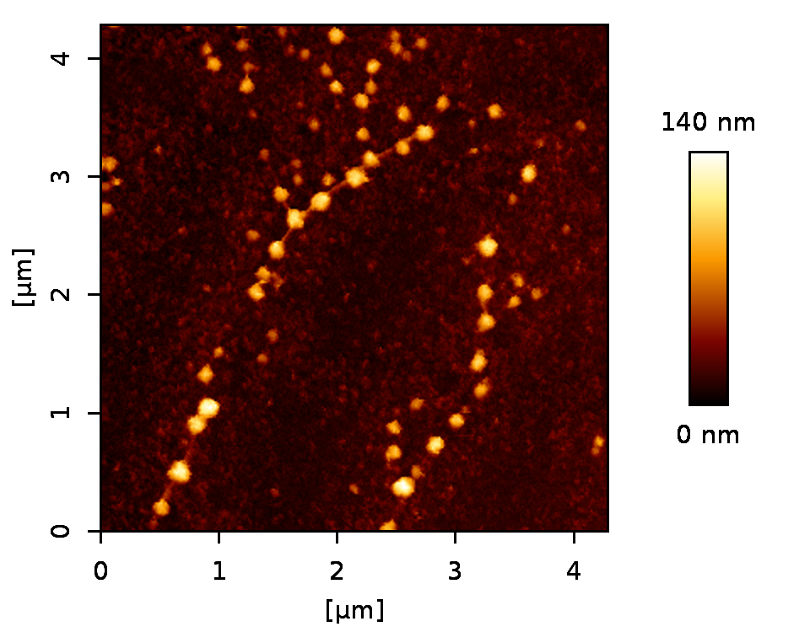
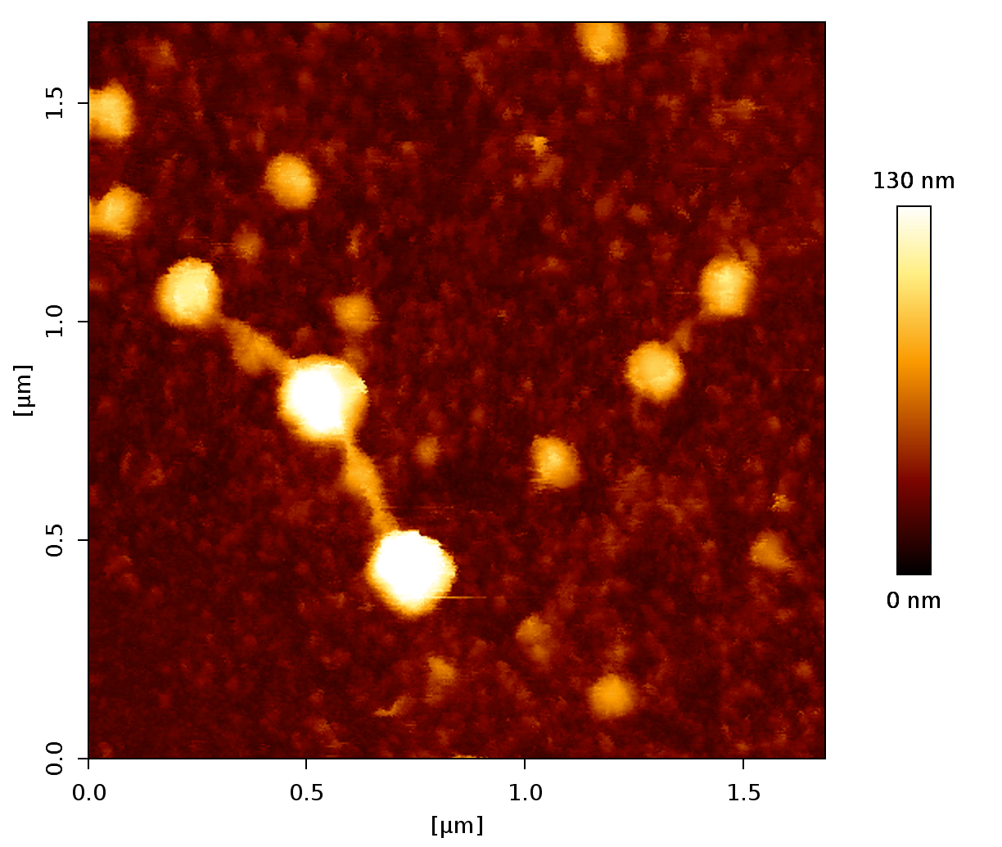
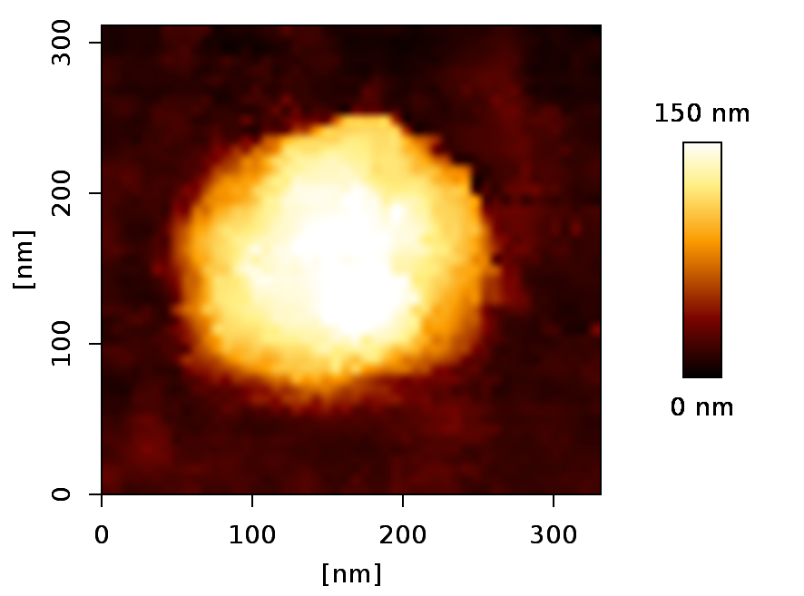
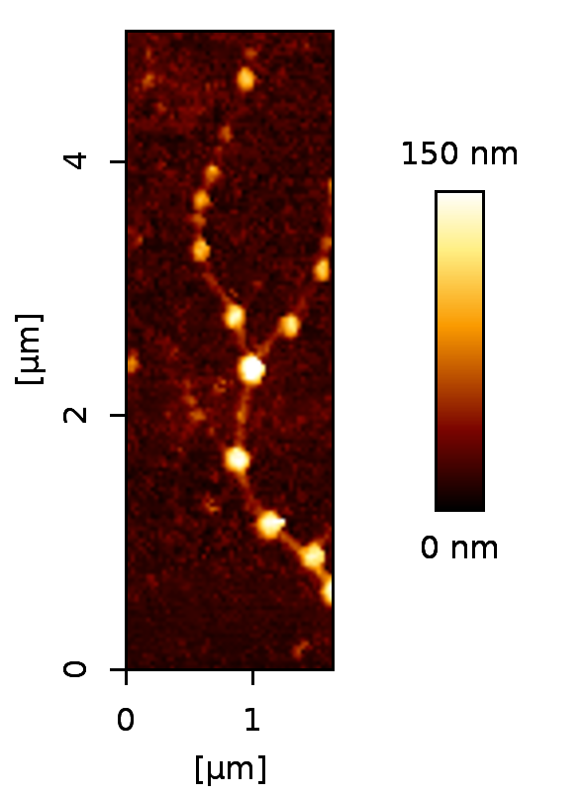
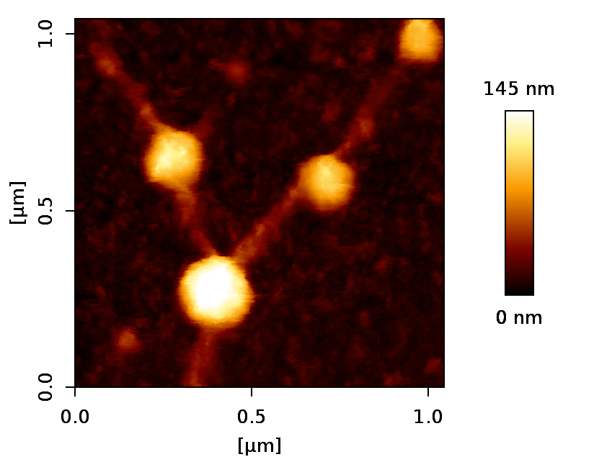
Atomic Force Microscopy of SARS-Cov-2 virions isolated from infected individual.
Virions appear to be connected to each other to establish a filament like structure.
Spike 22 nm
Collaboration with Delphine Muriaux and Sébastien Lyonnais (CEMIPAI facility)

